Slide 1
SPRING BOOT ORIENTATION
- Vishal V

Slide 2
Spring Framework initially gained popularity for being able to provide many functionalities of an Application Server like Transaction Management, Security Management, Container Management etc to be applied in Web Servers
Spring Framework is open source and easily configurable
Spring Framework can be integrated with View Framework like Tiles, JSF, Struts UI, Spring UI
Spring Framework can be integrated with several ORM frameworks
like Hibernate, Torque,

Slide 3
Is Spring Boot a module of Spring - Spring boot is a module of Spring to enable rapid development of Applications
Can Spring Boot do what Spring Framework does - Spring Boot is a part of Spring Framework , hence anything applicable to conventional Spring Applications is applicable to Spring Boot
Do we need Spring as we have Spring Boot - Spring Boot uses Spring Framework, so there is no Spring Boot without Spring Framework
Can we use Spring MVC in Spring Boot - There is no restriction in building a conventional Spring application , but with the growth of MEAN stack technologies like Angular , React JS, VUE JS it makes more sense to not use Spring MVC in some cases(e.g., Single Page Applications)
Can we build a standalone application with Spring Boot - Yes
Is it mandatory to use Spring Boot only in a Micro service environment - No
Why is Spring Boot more useful to build Micro Service Applications - Spring Boot has embedded tomcat servers and hence it makes it easier for deployment and in Container Management(Docker)
Can Spring Boot not be deployed on Application Servers - Spring Boot can be Deployed on Application servers as well, but it would require us to over-ride default configurations and change the WAR packaging style

Slide 4
How to configure a Spring Boot Application
Spring Boot CLI - e.g., spring init --build = gradle --java-version = 1.8 --dependencies = web,thymeleaf --packaging = war GradleApplication.zip
Spring Initializr - Go to the website, https://start.spring.io/ and select the libraries intended and apply the build.gradle/pom.xml file into your project
Spring Boot STS(Spring Tool Suite) - Can be integrated to Eclipse as plugin (https://spring.io/tools)

Slide 5
Hello World Demo Src Code available at https://github.com/Vishal-Vishu/Spring-Boot-Demo/

Slide 6
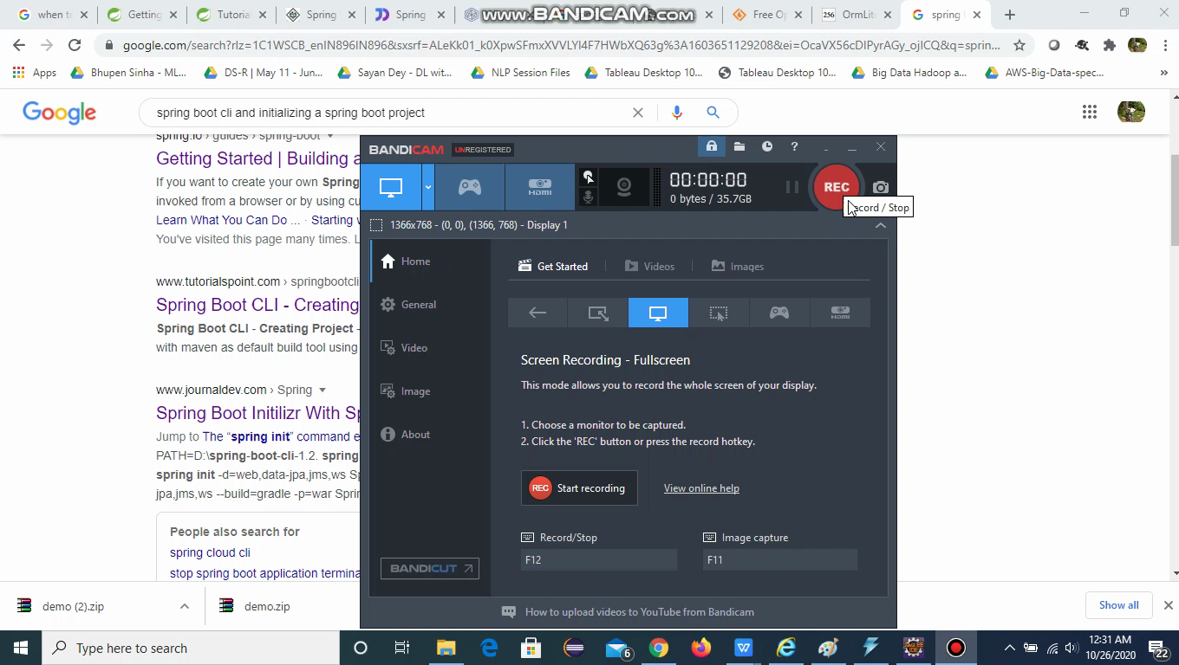

Slide 7
Change Tomcat Port and provide Web App context
Go to application.properties file
Add the below attribute and restart the application
server.port=<port number>
server.servlet.context-path=<context name here>

Slide 8
Food for thought???
We didnt install Tomcat
We didnt configure web.xml
We didnt worry about class path settings
We didnt provide any mappings for Dispatcher Servlet, View Resolver(Part of Spring MVC)
What is annotation
What is @RestController, how is it different from @Controller

Slide 9
Configure Spring Boot with Hibernate
Add the following tags in pom.xml
<dependency>
<groupId>org.springframework.boot</groupId>
<artifactId>spring-boot-starter-data-jpa</artifactId>
</dependency>
<dependency>
<groupId>mysql</groupId>
<artifactId>mysql-connector-java</artifactId>
<scope>runtime</scope>
</dependency>

Slide 10
Configure Spring Boot with Hibernate
Add the following config in application.properties file
## Spring DATASOURCE (DataSourceAutoConfiguration & DataSourceProperties)
spring.datasource.url = jdbc:mysql://localhost:3306/mysql
spring.datasource.username = root
spring.datasource.password = root
## Hibernate Properties
# The SQL dialect makes Hibernate generate better SQL for the chosen database
spring.jpa.properties.hibernate.dialect = org.hibernate.dialect.MySQL5InnoDBDialect
# Hibernate ddl auto (create, create-drop, validate, update)
spring.jpa.hibernate.ddl-auto = update

Slide 11
Configure Spring Boot with Hibernate
Create a Entity Class
Create a JPA Repository , map it to the Entity Class
In the controller/service class refer to the Repository
Use the Hibernate API's to perform CRUD method
Things to focus on @Repository, @Autowired , @Entity

Slide 12
Configure Spring Boot with Log4J
Update the spring-boot-starter-web dependency as below
<dependency>
<groupId>org.springframework.boot</groupId>
<artifactId>spring-boot-starter-web</artifactId>
<exclusions>
<exclusion>
<groupId>org.springframework.boot</groupId>
<artifactId>spring-boot-starter-logging</artifactId>
</exclusion>
</exclusions>
</dependency>
<dependency>
<groupId>org.springframework.boot</groupId>
<artifactId>spring-boot-starter-log4j2</artifactId>
</dependency>

Slide 13
THANK YOU

